Slide 1

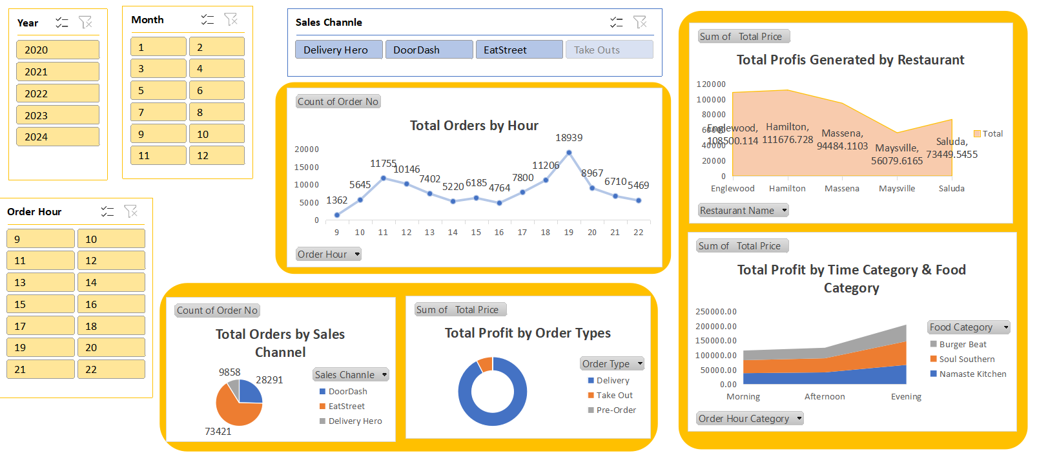

Slide 2
Insights
The highest number of orders (18,939) occurs at 6:00 PM, confirming that evenings are the busiest period for the business.
Best business hours are from 5:00 PM to 9:00 PM, with consistently high order volumes and profitability.
The lowest number of orders (1,362) is recorded at 9:00 AM, indicating minimal customer activity during early morning hours.
Delivery Hero leads in order volume, followed by EatStreet and DoorDash, contributing significantly to the business's revenue stream.
Delivery orders dominate profitability, followed by Take-Out and Pre-Orders.
Pre-orders, however, account for a smaller share of total profits, indicating potential for growth in this segment.
Hamilton generates the highest profit ($111,676.73), showcasing strong regional performance.
In contrast, Maysville records the lowest profit ($56,079.62), highlighting the need for targeted strategies to improve profitability in this area.
Soul Southern performs consistently well across all time slots, reflecting its broad customer appeal and strong operational efficiency.

Slide 3
Insights
Other food categories, such as Namaste Kitchen, show peak performance in specific time slots, suggesting the need for tailored promotions during those periods.
Evening orders not only dominate in volume but also contribute significantly to profits across all food categories.
Despite the high volume of evening orders, profit margins remain strong, affirming the efficiency of operations during these hours.
A significant drop in orders is observed between 2:00 PM and 4:00 PM, indicating a potential opportunity to drive demand through midday promotions or targeted campaigns.

Slide 4
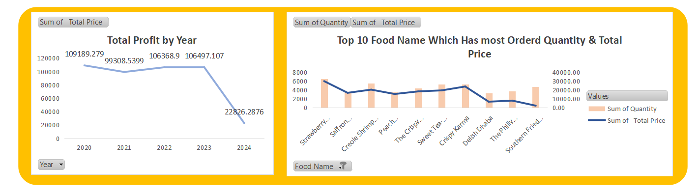

Slide 5
Recommendations
From 2020 to 2023, profit remained relatively stable, reflecting steady business performance during those years.
2020 was the best-performing year, with profits peaking at $109,189.28, setting a benchmark for business success.
Items like Strawberry, Crispy Karma, and Creole Shrimp consistently rank high in both quantity sold and total price, indicating strong customer demand.
Items such as Sweet Tea show a disparity between quantity sold and total price, suggesting a need to evaluate pricing strategies.
Products like Crispy Karma and Delish Dhaba significantly contribute to total revenue, emphasizing their importance in the menu.
The popularity of items like Strawberry suggests that demand fluctuates seasonally, presenting an opportunity to optimize sales during peak seasons.
Lower demand for items like Sweet Tea may reflect changing customer preferences, requiring a deeper analysis of consumer trends.

Slide 6
Suggestions
Increase staff and streamline kitchen processes during peak hours to handle high order volumes efficiently.
Promote pre-order options with discounts or special offers to increase their share.
Extend evening hours or offer special evening menus to capitalize on this trend.
Introduce mid-afternoon snacks or happy hour deals to increase orders during this time.
Implement a system for collecting and analyzing customer feedback to improve services and offerings.
Promote these products as premium offerings and introduce similar items to capitalize on their success.

Slide 7

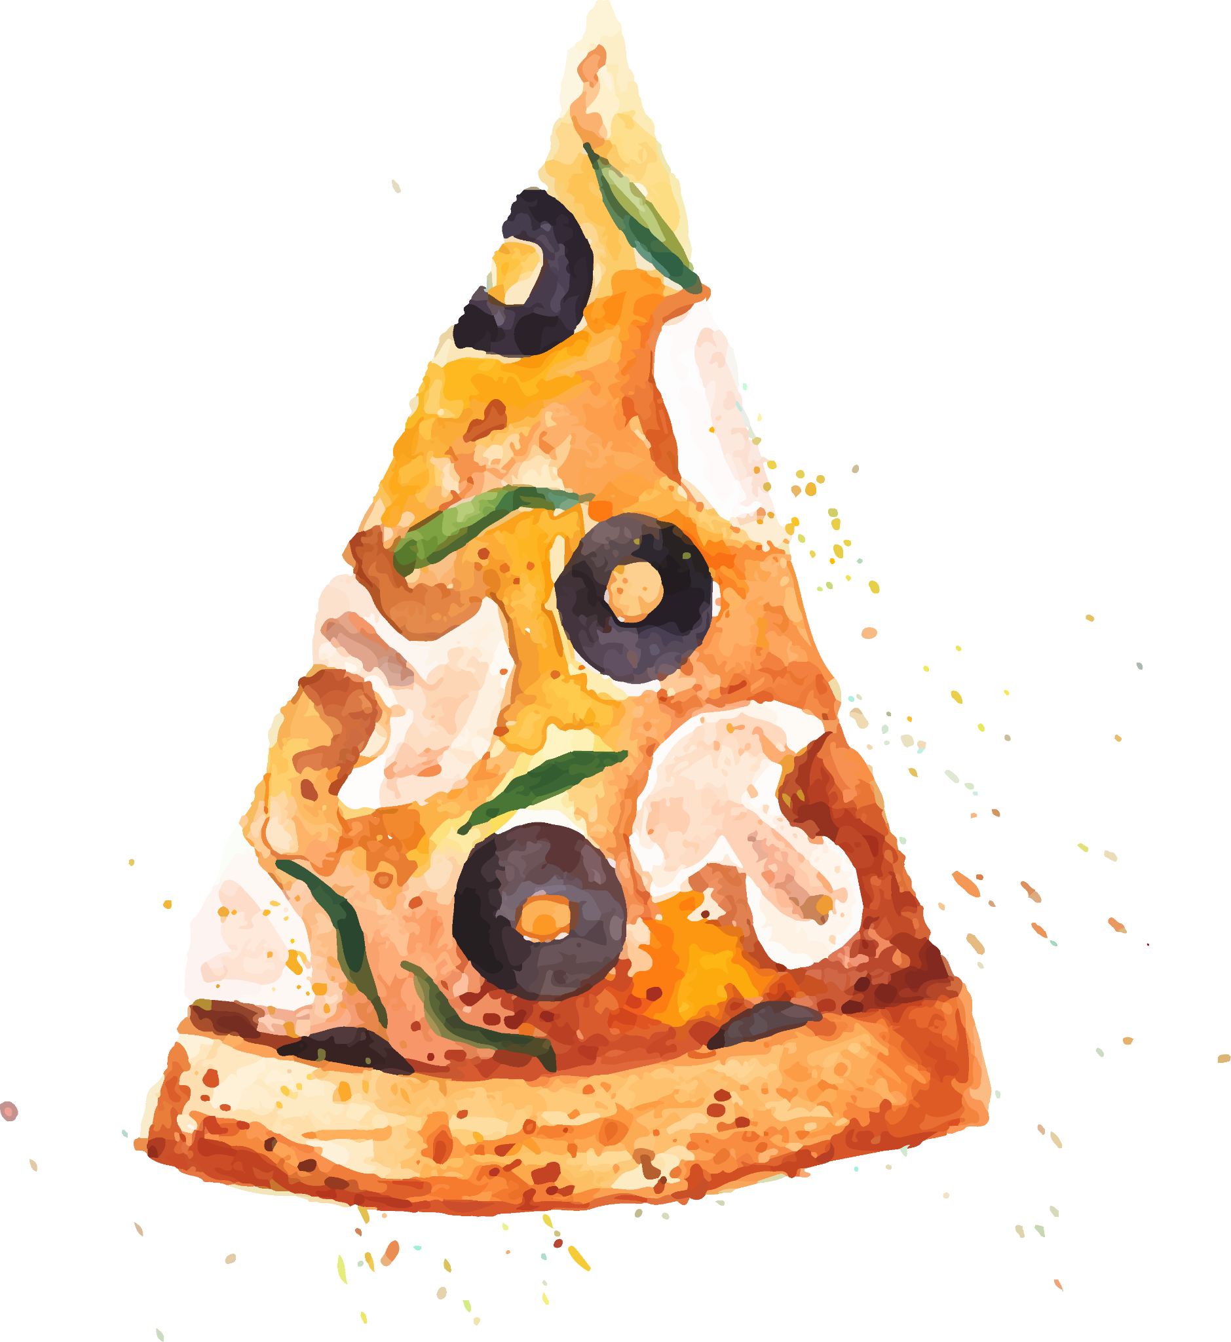
THANKS!
Do you have any questions?
jatinbhavsar000@gmail.com
+91 9924750166

